Slide 1
7 Days of Recipes
Backstreet boys:
Frank beatrice
Angel Trinh
William Vasquez
JeffREY yourman

Slide 2
Why 7 Days of Recipes?
Feeding Innovation
Randomize recipes for each day of week to drive consumers to make different food cuisines
Meal Planning Keeps things Organized
Application will drive to ToDoIst app to consolidate ingredients in one shopping list; making grocery shopping seamless.
App will compare ingredients that are at home vs ingredients needed
Efficiency
Send all ingredients to an online grocery store to purchase items for meals, thus making grocery shopping easy
s

Slide 3
Advantages
Maintaining a Healthy Lifestyle
A better lifestyle is subconsciously encouraged because consumers will know all the ingredients
Saving Money
Cooking is generally more budget friendly than ordering food delivery
Time Restriction
Users will have the option to choose recipes in certain time frames, making it easier to cook
Diet Restriction
Users will have the option to choose between vegan, vegetraian, paleo, dairy –free, gluten-free, wheat-free, fat-free, low-sugar, egg-free, peanut-free, tree-nut free, soy-free, fish-free, shellfish-free
s

Slide 4
Information About How our App Was Built
APIs used
To Doist App
Edamam App
Twitter

Slide 5
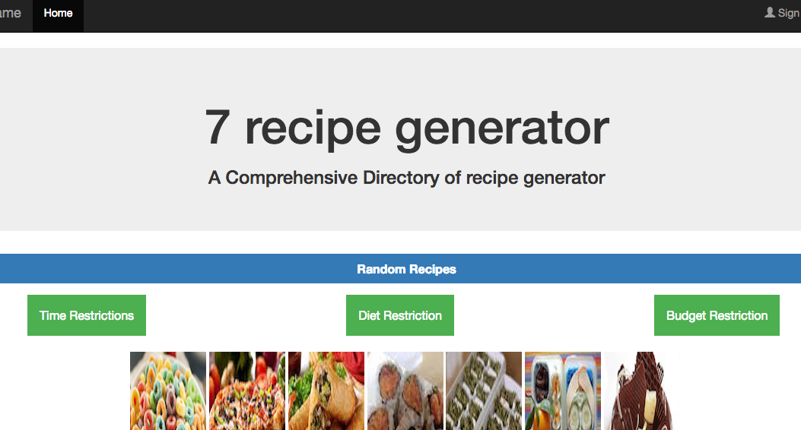
Demo

